Slide 1


DESIGN AND DEVELOPMENT OF ARTIFICIAL WIND TREE FOR OFF-GRID POWER GENERATION by PRANAV V SARMA 310614105066 RAHUL M 310614105077 RENGANATHAN R 310614105080 SAI PRASAD D 310614105084 under the Guidance of Dr. E.KALIAPPAN HOD, EEE Department Easwari Engineering College Ramapuram.

Slide 2
CONTENTS
Abstract
Literature review
Introduction
Objective
Existing system and its disadvantages
Proposed system and its advantages
Block diagram and operation
Design calculations
Final design and layout
Conclusion
Scope for future works
References

Slide 3
ABSTRACT
Wind energy and solar energy are considered to be the most reliable and efficient among other renewable energy sources.
But the commercial windmills require large installation space, have high capital and maintenance costs, rotates only at high velocity and the output power is discontinuous and seasonal.
Hence in this project, we shall see the concept of power generation using both wind energy and solar energy.

Slide 4
ABSTRACT contd..
In this project, the Wind tree is used to generate electricity with the help of Aero leaves and a solar panel.
The power generated from the tree overall, is stored in the battery, which then powers the load using an inverter.

Slide 5
LITERATURE REVIEW
“A novel design of a Savonius wind turbine water heating in residential settings” by P. Clague, T. Z. Qi, Published Mechatronics and Machine Vision in Practice at New Zealand, IEEE- 2008
“Design And Development Of Hybrid Vertical Axis Turbine” by Md. Jahangir Alam, M.T. Iqbal, IEEE- Electrical and Computer Engineering, 2009.
“Vertical axis wind turbine” by Pranit Nagare, Rammohan Shettigar, Arnav Nair, Pratibha Kale, Prasanna Nambiar, IEEE- Technologies for Sustainable Development (ICTSD), 2015.

Slide 6
LITERATURE REVIEW contd...
Electromagnetic Design of a New Axial Flux Generator” by Erol Kurt, Halil GÖR, IEEE- Electronics, Computers and Artificial Intelligence (ECAI), 2014
“Model of Coreless Axial Flux Permanent Magnet Generator”, Natalia Radwan- Praglowska, Dariusz Borkowski, Tomasz Wegiel, IEEE- Electrical Machines (SME), 2017
“Design and Construction of a Permanent Magnet Axial Flux Synchronous Generator”, Rogel R. Wallace, Thomas A. Lipo, Luis A. Moran, Juan A. Tapia, IEEE- Electric Machines and Drives Conference Record, 1997.

Slide 7
INTRODUCTION
Most of the energy sources used nowadays are of non renewable energy sources, which include Petrol, Diesel, Coal, etc.
The over usage of such energy sources has led to the degradation of environment and has also contributed to climate change, ozone layer depletion and many other stressing problems
Hence, the demand for cleaner power generation and transmission is increasing day by day in the present century.

Slide 8
INTRODUCTION contd..
There are different types of renewable energy sources available, which include Wind, Solar, Hydro, Biogas, Geothermal, Tidal, Biofuel etc.
Here in this project we shall see the concept of power generation using both wind energy and solar energy, using a structure integrating both the sources, called as the Wind tree.

Slide 9
OBJECTIVE
To create a wind tree that can operate even at low wind speeds, as low as 7 m/s.
To create a wind tree that is noiseless and doesn’t require much land space.
To create a wind tree that is cheaper, requires less maintenance, robust in construction and is highly reliable

Slide 10
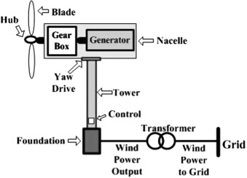
EXISTING SYSTEM

Slide 11
DISADVANTAGES OF EXISTING SYSTEM
Massive tower construction is required to support the heavy blades, gearbox, and generator.
Components of a horizontal axis wind turbine (gearbox, rotor shaft and brake assembly) being lifted into a position which is difficult
Downwind variants suffer from fatigue and structural failure caused by turbulence when a blade passes through the tower's wind shadow.
HAWTs require an additional yaw control mechanism to turn the blades toward the wind. It also requires a braking or yawing device in high winds to stop the turbine from spinning and destroying or damaging itself.

Slide 12
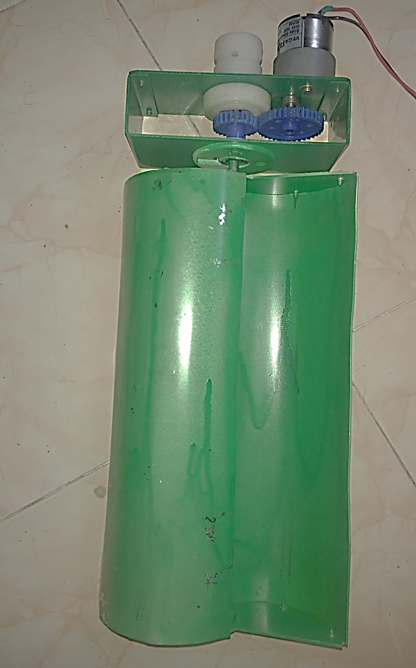
PROPOSED SYSTEM

Slide 13
ADVANTAGES OF PROPOSED SYSTEM
No yaw mechanisms are needed.
A VAWT can be located nearer the ground, making it easier to maintain the moving parts.
VAWTs have lower wind startup speeds than the typical the HAWTs.
VAWTs may be built at locations where taller structures are prohibited.
VAWTs situated close to the ground can take advantage of locations where rooftops, mesas, hilltops, ridgelines, and passes funnel the wind and increase wind velocity.

Slide 14
BLOCK DIAGRAM AND OPERATION
WIND
WIND TURBINE
CHARGE CONTROLLER
BATTERY
INVERTER
SUN RAYS
SOLAR PANEL
LOAD

Slide 15
BLOCK DIAGRAM AND OPERATION contd…
In this concept, wind energy is used to generate electricity with the help of Aero leaves. These Aero leaves are made of aluminium, which is cut and assembled into a specified shape based on the requirement.
Here we are using a Permanent magnet DC generator which will be equal to the number of Aero leaves. This model mainly works on the principle of “Faradays law of electromagnetic induction‟

Slide 16
BLOCK DIAGRAM AND OPERATION contd…
Aero leaves starts to rotate with minimum speed of 7 m/s when air flows through it.
As Aero leaves are directly coupled to the dynamo; where mechanical energy gets converted into electrical energy
It is because of the fact that the generator consists of armature (magnet) and the field coil. An EMF is induced due to the relative motion between the rotating armature and magnetic field due to field coil.

Slide 17
BLOCK DIAGRAM AND OPERATION contd…
Meanwhile, the solar energy from the sun is directly converted to DC power using the solar panel.
All aero leaf along with its generators are connected in series and
This resulting DC output is given to the charge controller, which prevents the overcharging of the battery.
The output power is then stored in a battery. Power from the battery is then used to drive the load.

Slide 18
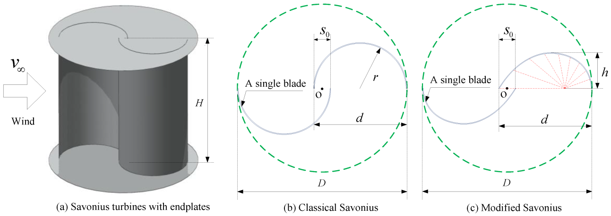
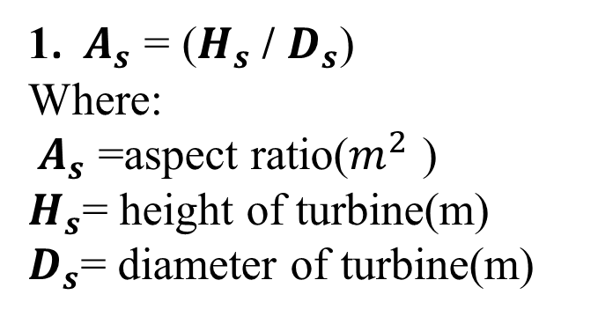
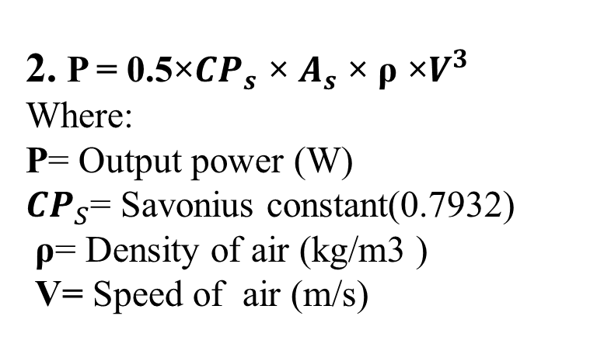
DESIGN CALCULATIONS
1. $A_{s}$ = ($H_{s}$/ $D_{s}$)
Where:
$A_{s}$ =aspect ratio($m^{2}$ )
$H_{s}$= height of turbine(m)
$D_{s}$= diameter of turbine(m)
2. P = 0.5×${CP}_{s}$ × $A_{s}$ × ρ ×$V^{3}$
Where:
P= Output power (W)
${CP}_{S}$= Savonius constant(0.7932)
ρ= Density of air (kg/m3 )
V= Speed of air (m/s)
SAVONIUS ROTOR

Slide 19
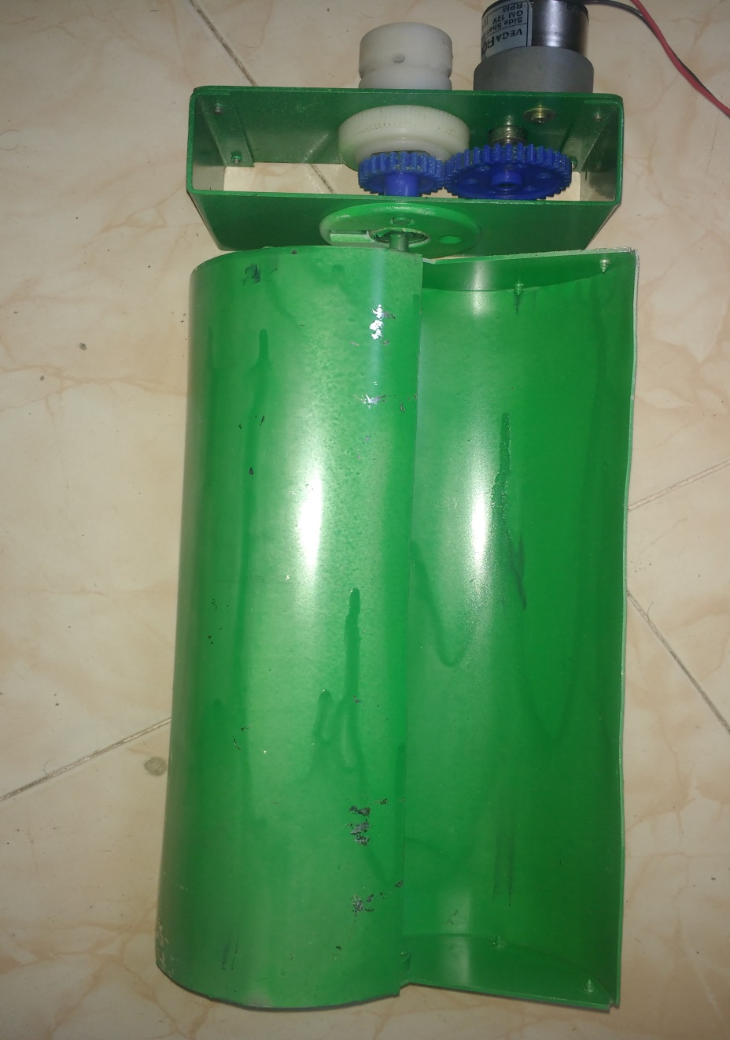
FINAL DESIGN
Diameter: 140 mm
Height: 280 mm
Aspect ratio: 2
DC generator output: 4V
at 7 m/s
AERO LEAF

Slide 20
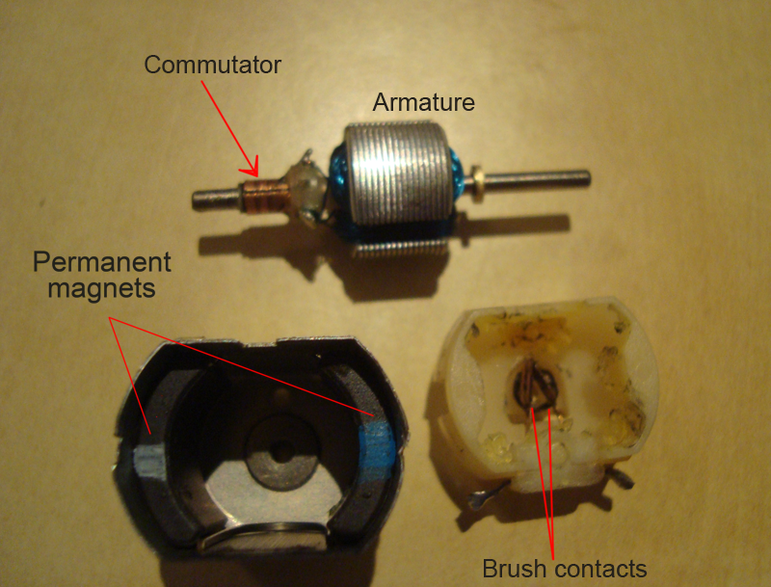
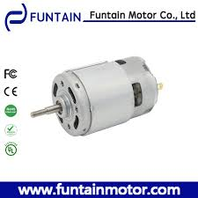
FINAL DESIGN contd..
DC GENERATOR

Slide 21
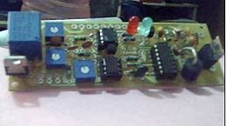
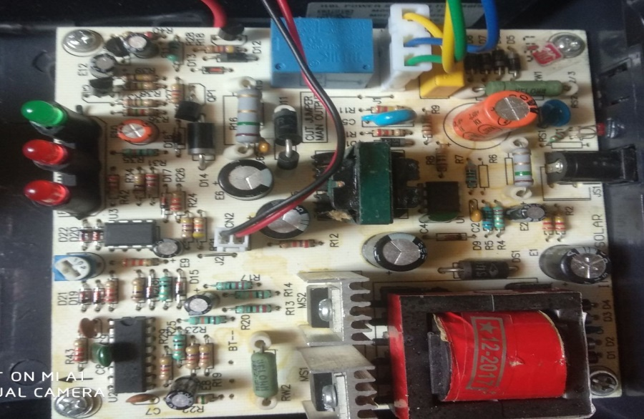
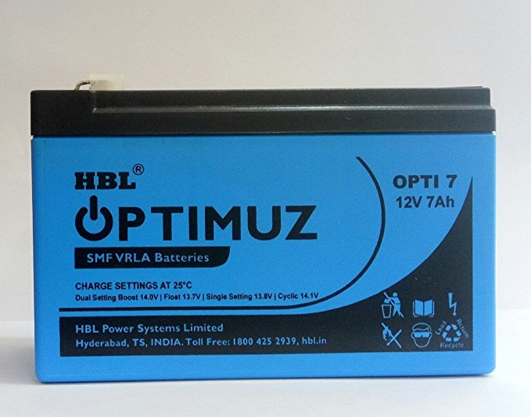
FINAL DESIGN contd..
CHARGE CONTROLLER
INVERTER
Battery specifications:
12V, 7 Ah, sealed-maintenance free (SMF) valve regulated lead acid (VRLA) battery
BATTERY

Slide 22
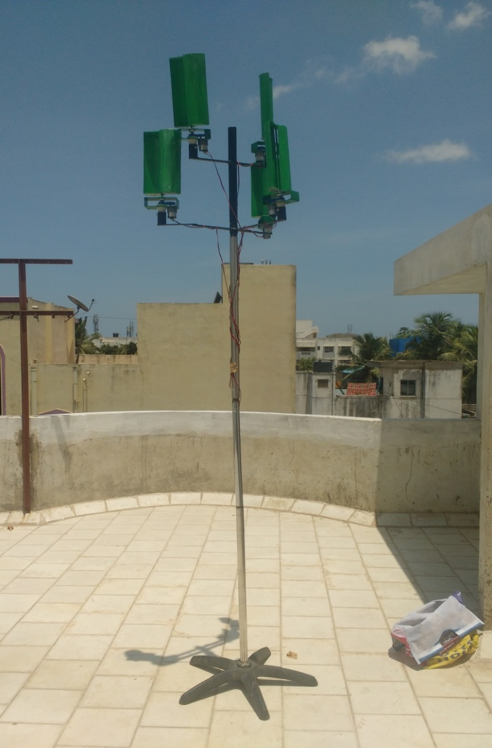
FINAL DESIGN contd..
Overall height: 8 feet
Diameter of Stem: 1.5 inch
Stem material: Stainless steel
Length of branches: 60 cm
Branch material: Mild Steel
TREE STRUCTURE

Slide 23
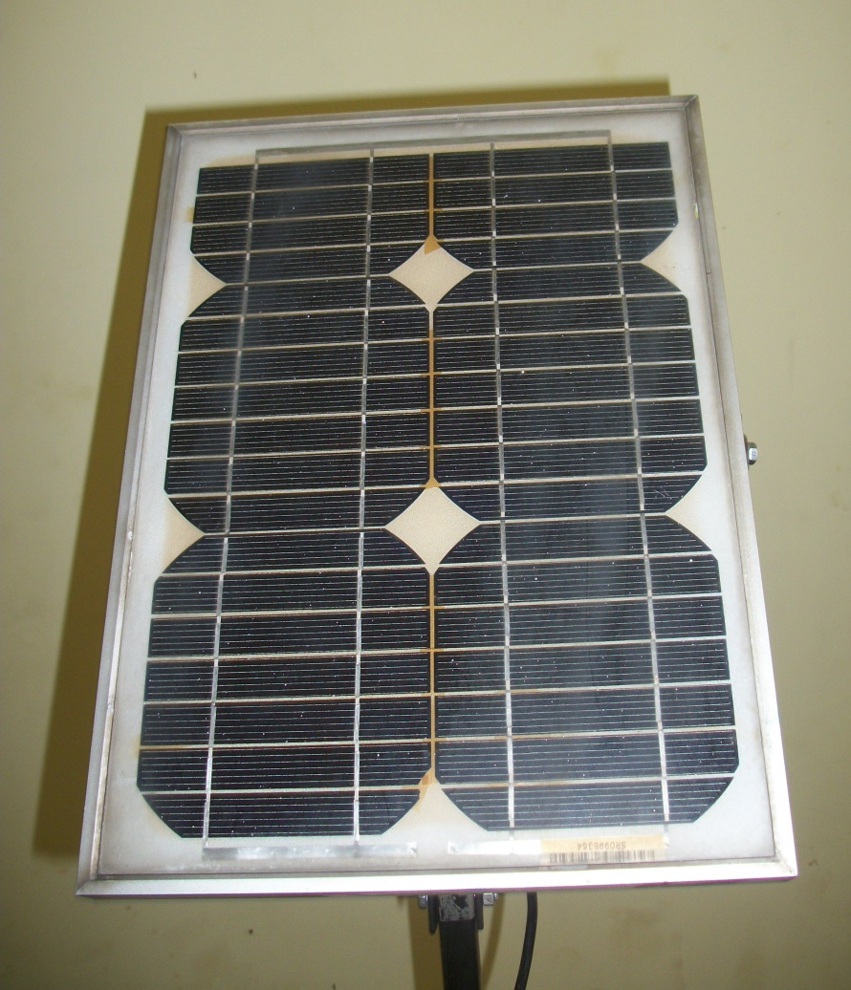
FINAL DESIGN contd..
Output Power: 10W
Output Voltage: 15V
SOLAR PANEL

Slide 24
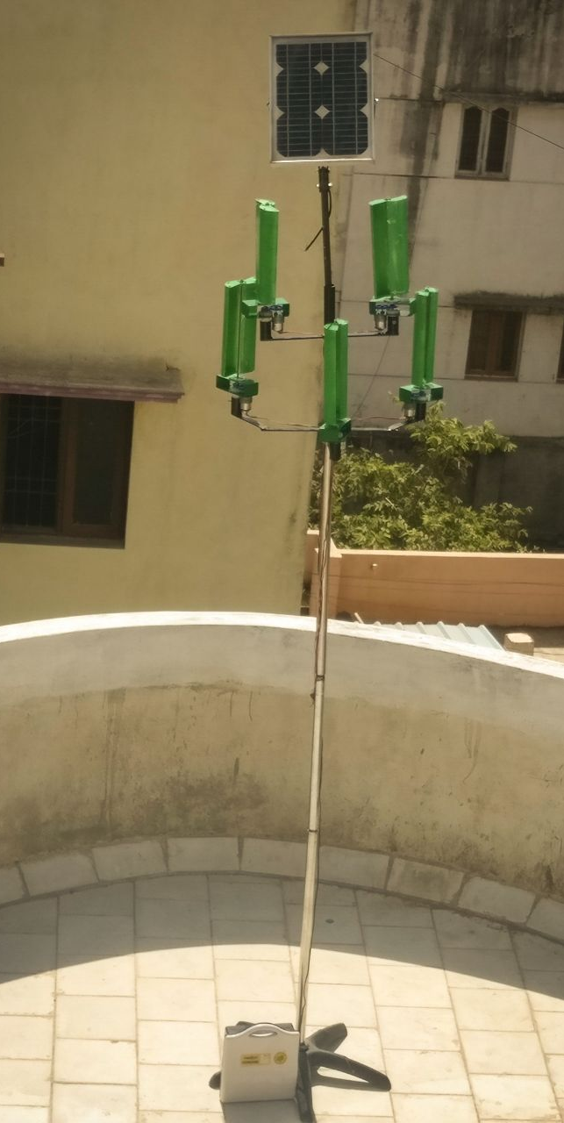
FINAL LAYOUT

Slide 25
CONCLUSIONS
The main objective of the project has been presented and the wind tree that has been successfully implemented can generate electric power using Aero leaves and a solar panel to power lighting devices.
It occupies small size, generates very less noise, has lesser capital and maintenance costs and can be set up in households in contrast to conventional windmills.
Due to the increasing demand for clean energy, these kind of energy sources improve and promote the concept of clean power generation.

Slide 26
SCOPE FOR FUTURE WORKS
In this proposed project, the solar panel is fixed rigidly in a particular angle to receive the solar energy. By using a panel which moves accordingly to the sun’s direction, we can obtain maximum efficiency for the solar panel. This technology is still in research process.
During highly extreme weather conditions, the high wind speed can damage or either break the Aero leaf. In order to avoid this condition, a mechanical brake can be used to stop the motion of the leaf.
By fixing a flexible solar panel made of nanomaterial over the turbine itself, solar energy can be harnessed along with wind energy without appreciable rise in temperature of the panel.

Slide 27
REFERENCES
[1] Borowy, B.S.; Salameh, Z.M. Dynamic response of a stand-alone wind energy conversion system with battery energy storage to a wind gust. IEEE Trans. Energy Conver. 1997, 12, 73–78.
[2] E. Muljadi, C.P. Butterfield, Yih-Huei Wan, “Axial Flux, Modular, Permanent-Magnet Generator with a Toroidal Winding for Wind Turbine Applications,” Proceeding of the IEEE Transactions on Industry Applications, November 5-8,1998.
[3] E. Spooner, A. Williamson, “Modular, Permanent-magnet Wind-turbine Generators,” Conference Record of the 1996 IEEE Industry Applications Society, Oct. 6-10, 1996, San Diego, California, Volume 1, pp. 497-502.
[4] Yicheng Chen, Pragasen Pillay, “Axial-flux PM Wind Generator with A Soft Magnetic Composite Core,” Proceeding of the IEEE ,2005
[5] N.S. Cetin, M.A. Yurdusev, R. Ata and A. Ozdemir , “Assessment of Optimum Tip Speed Ratio of Wind Turbine,” Vol.10, No.1, pp 147-154, 2005
[6]B. Jones, “Elements of Aerodynamics”, John Wiley and sons, New York, USA , pp 78-1581950

Slide 28
REFERENCES contd…
[7] Ibrahim Al-Bahadly ,“Building a wind turbine for rural home”, 2009
[8] Mariusz Malinowski, Adam Milczarek,Radoslaw Kot, Zbigniew Goryca and Jan T. Szuster,“Renewable energy source in modern distributed power systems”, 2015
[9] Sukanta Roy, Ujjwal K. Saha ,“Review on the numerical investigations into the design and development of Savonius wind rotors” 2013
[10] P. Wannakarn, T. Tanmaneeprasert, N. Rugthaicharoencheep,“Construction of Axial flux Permanent Magnet Generator for Wind Turbine generated DC Voltage at rated power 1500W.”, 2011
[11] Tareq S. El-Hasan, Patrick C. K. Luk, Member, IEEE, F. S. Bhinder, and M. S. Ebaid “Modular Design of High-Speed Permanent-Magnet Axial-Flux Generators”, 2009
[12] B.J. Chalmers, E. Spooner, W. Wu, “Axial flux permanent magnet generator for a gearless wind energy system”, 1999
[13] Md. Jahangir Alam, M.T. Iqbal , “Design and development of hybrid vertical axis turbine”, 2009

Slide 29
THANK YOU

